Slide 1
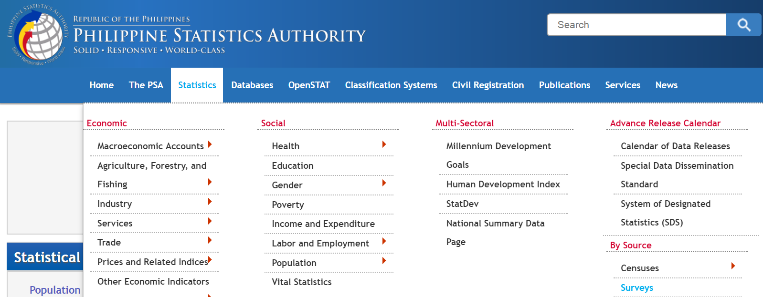
Procedure to obtain PPI data for Philippines
Go to the website of “Philippines Statistics Authority”
Click on “Statistics” and then scroll down to bottom right to locate “Surveys”
psa.gov.ph

Slide 2
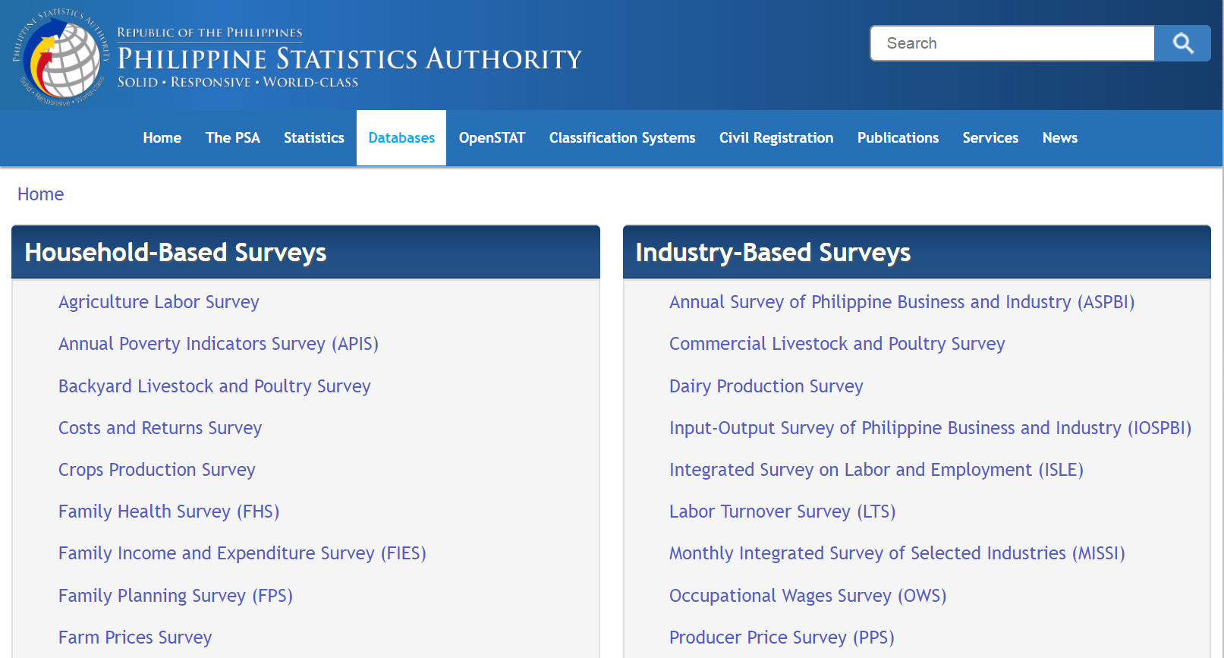
Procedure to obtain PPI data for Philippines
Locate “Industry-Based Surveys” and then scroll down to click on “Producer Price Survey”

Slide 3
Procedure to obtain PPI data for Philippines
Locate the latest “Producer Price Survey” and click on it
Scroll down the page and click on “TABLE 1 Producer Price Index, Year-on-Year and Month-on-Month Growth Rates for Manufacturing Sector” to open the excel file.
`

Slide 4
Procedure to obtain PPI data for Philippines
Locate the Industry of interest in the Excel
The PPI values are showed in one of the columns

